Slide 1

CONNECT 4
Yuchen luo

Slide 2

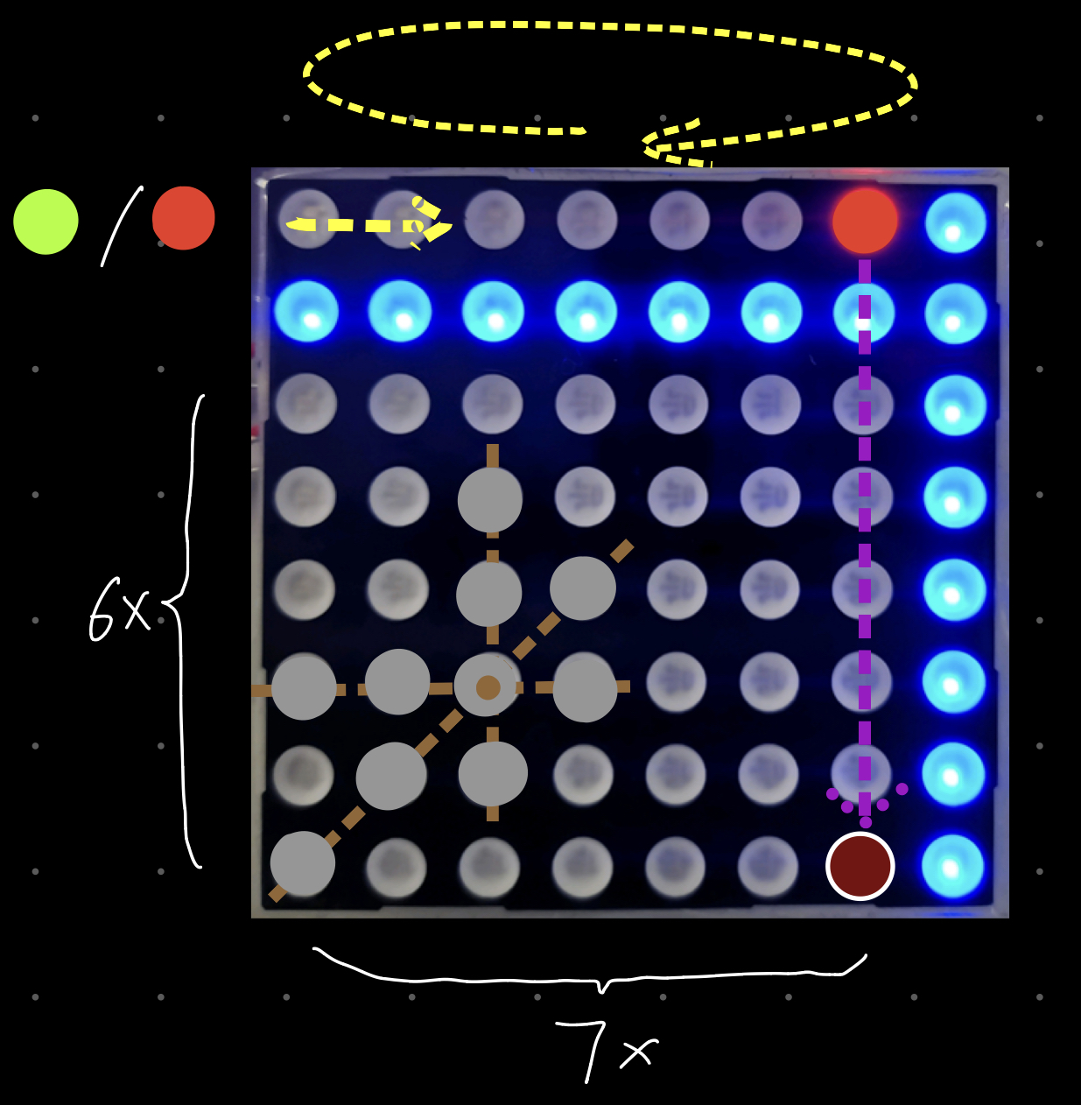
User Guide
Here is a LED shifting
The players choose a color and then take turns dropping colored LEDs into a six-row, seven-column grid.
When the player press the button, which color drop straight down, occupying the lowest available space within the column
The objective of the game is to be the first to form a horizontal, vertical, or diagonal line of four of one's own colors.

Slide 3
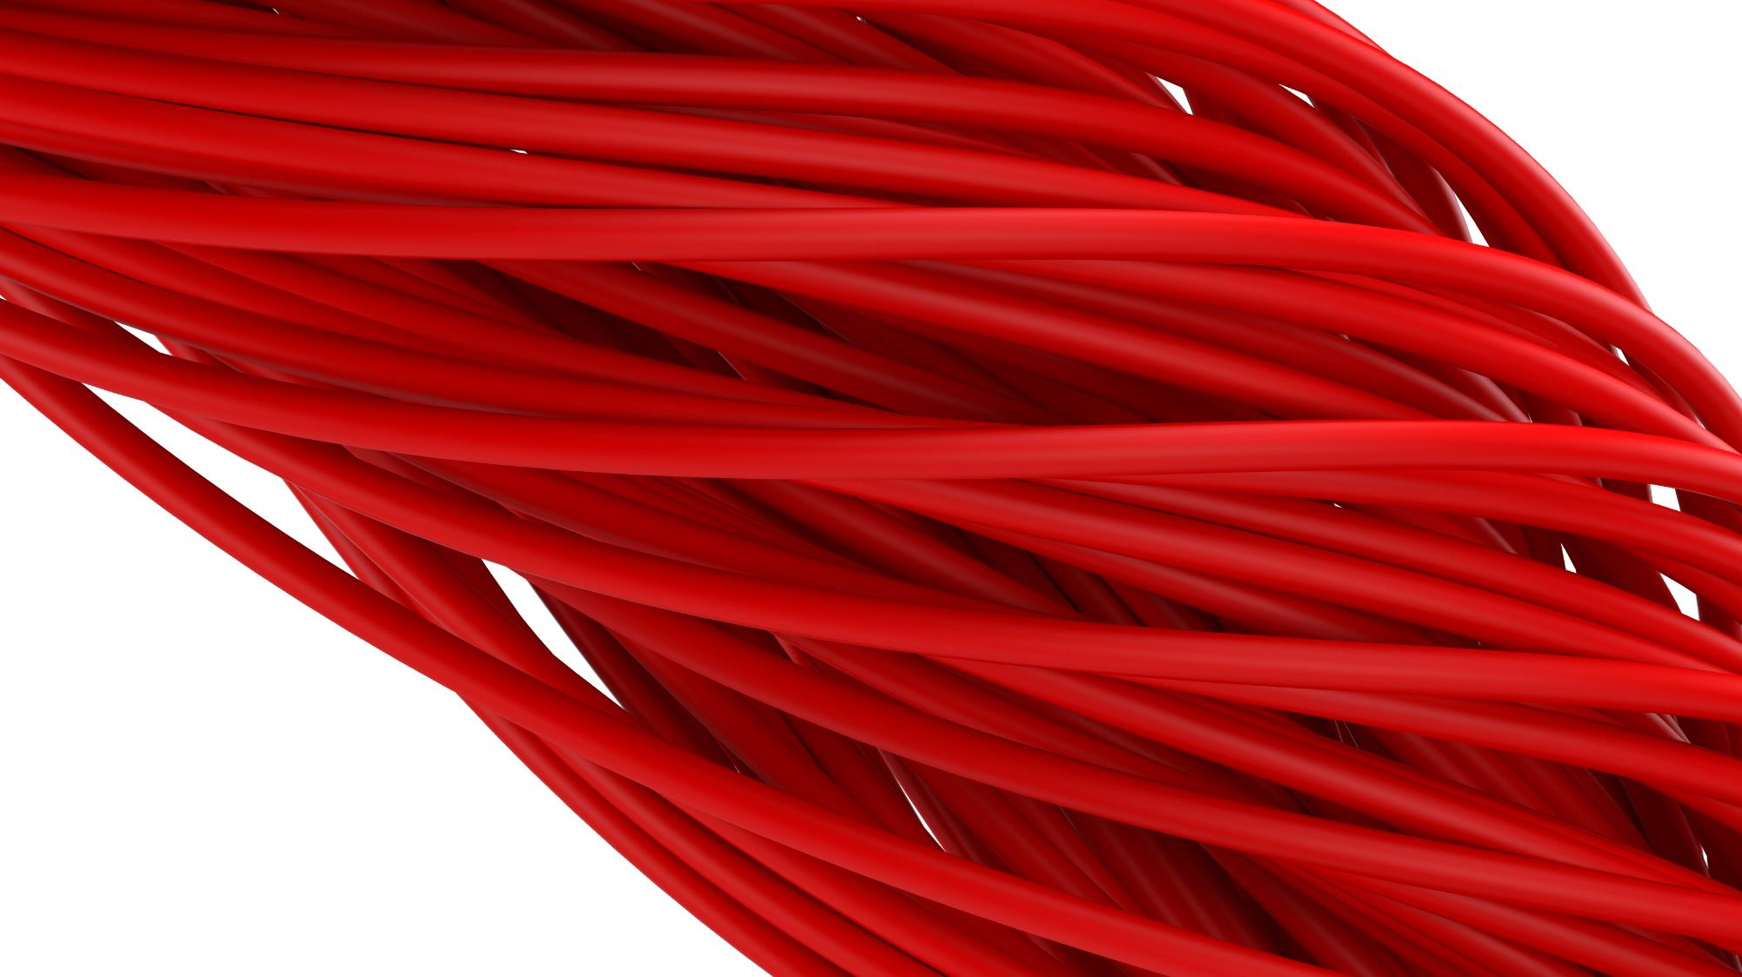
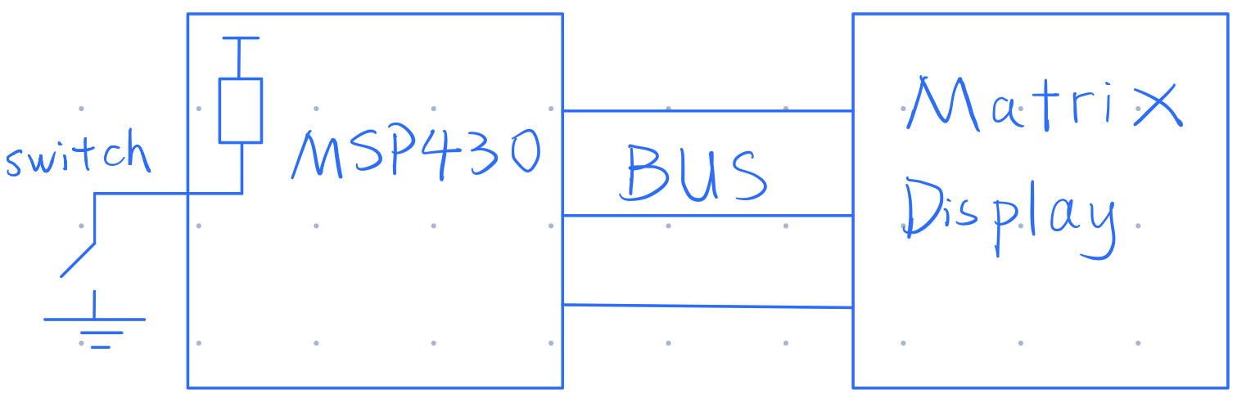
Main Components

Slide 4
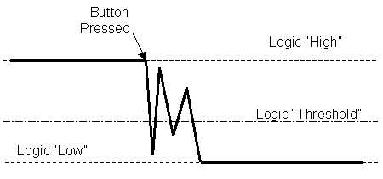
Button Bounce
When the button is pressed, it is does not change directly from high to low.
Diagram Button Bounce Reference[1]
Solution: To poll the switch pin until it changes,
then wait for 20ms and then to read it again to see if the change is valid.

Slide 5
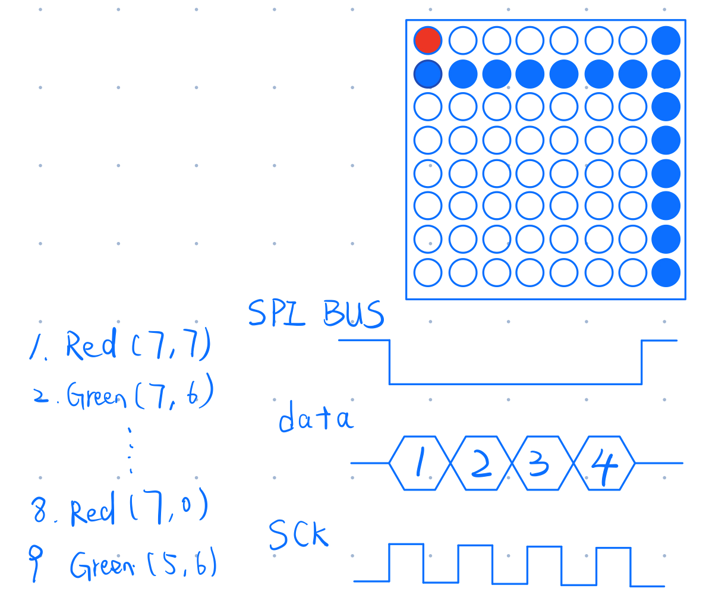
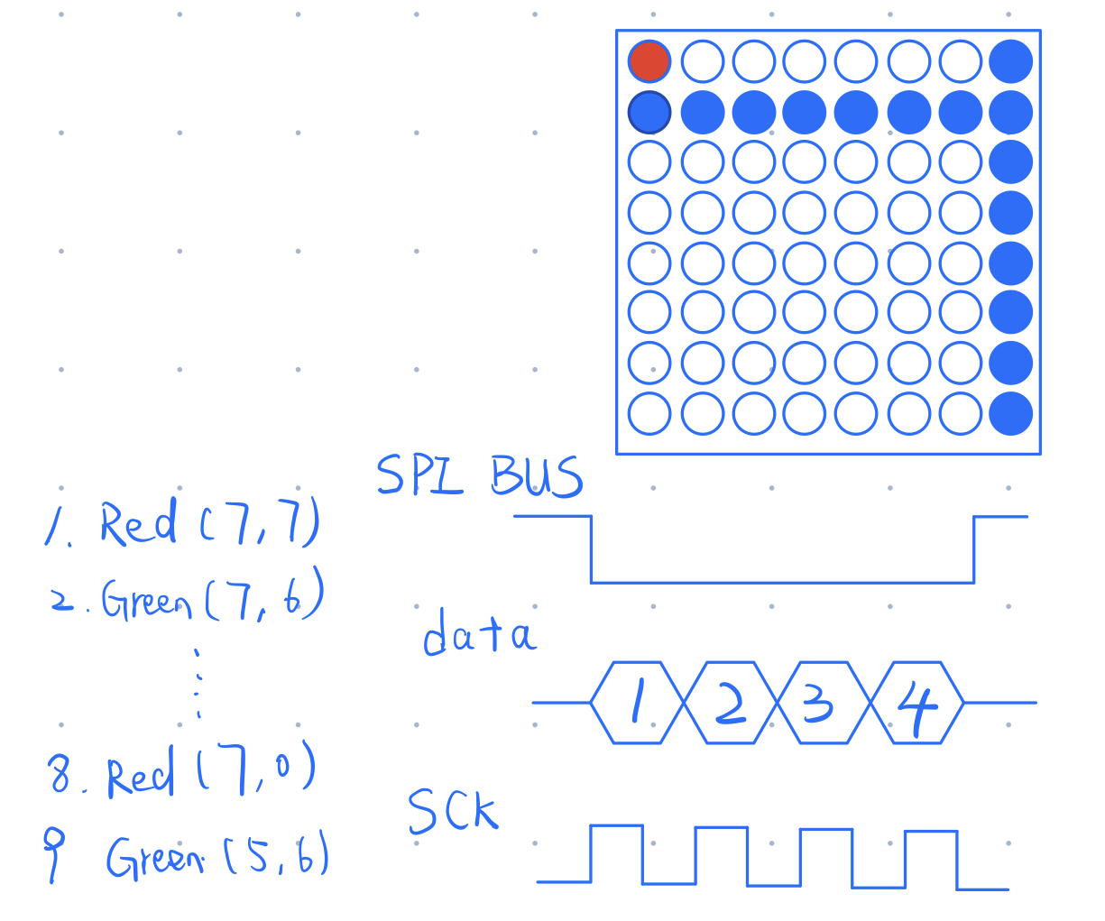
How to do

Slide 6
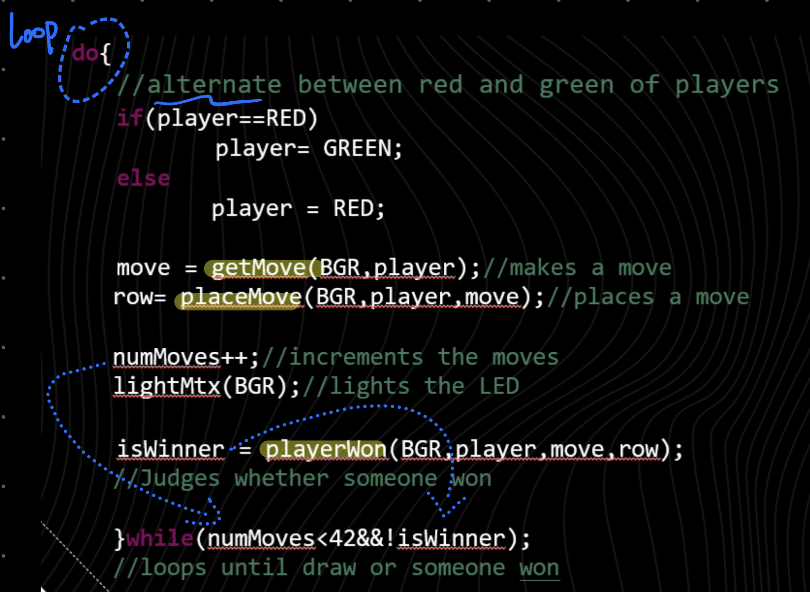
Main Processes

Slide 7
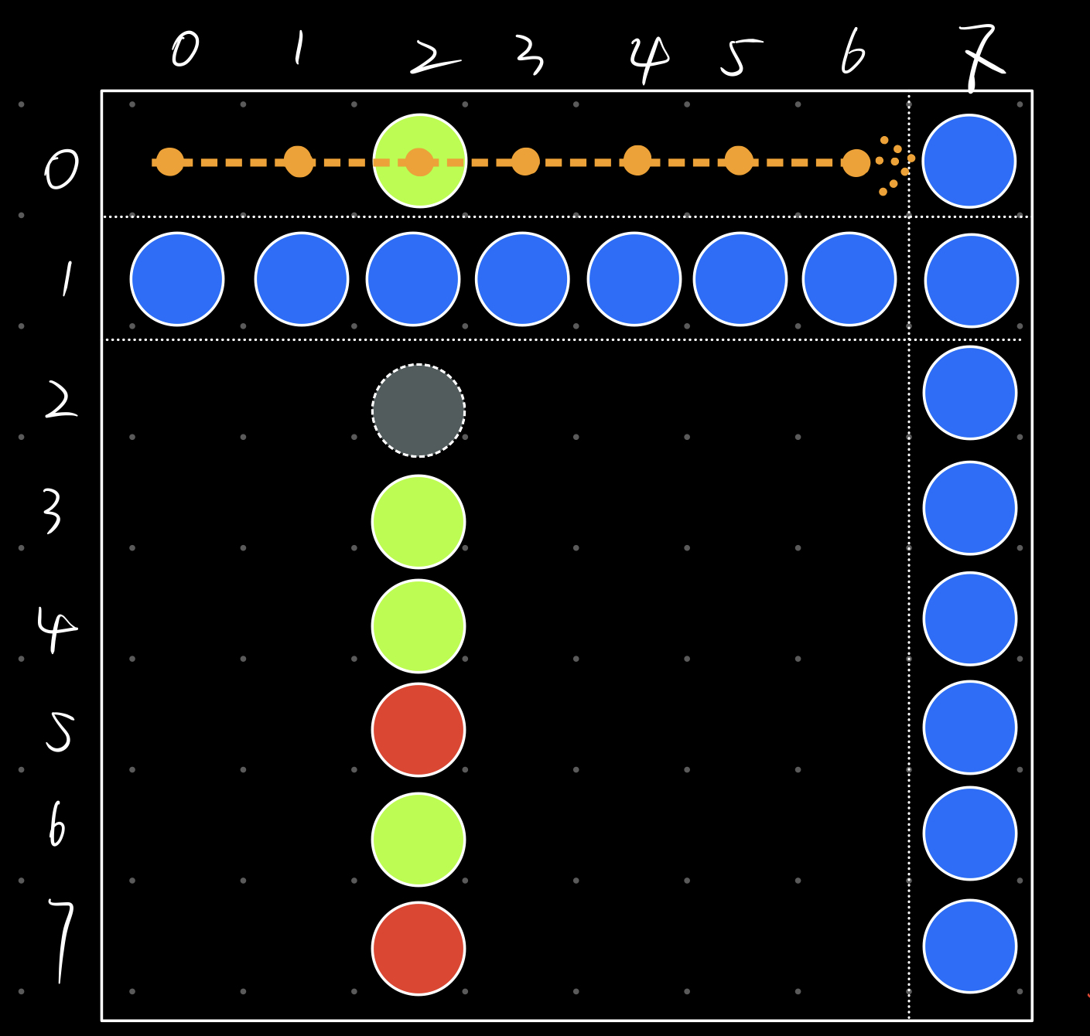
How to get move
Loop in the row zero:
Loop a LED to shift from left to right,
delay for a while in each position
Judge whether a valid move:
Check row[2] whether occupied, making sure the program can be processed

Slide 8
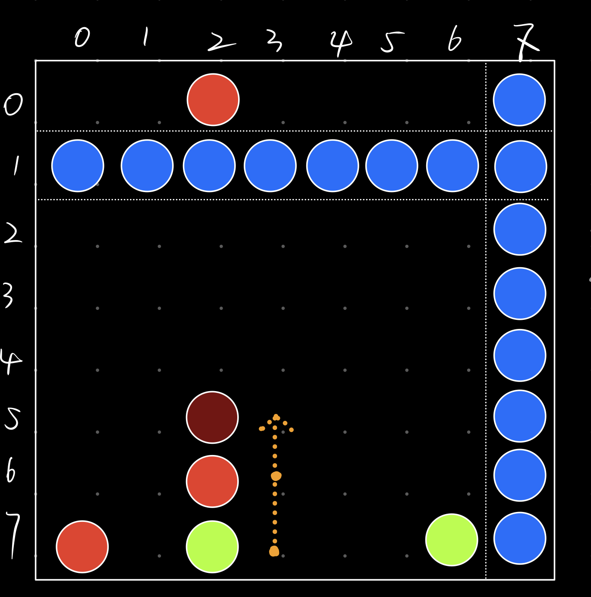
How to place move
Place move:
Make sure the red LED drop into the right position:
Get the bottom position
Find the empty position from the bottom up

Slide 9
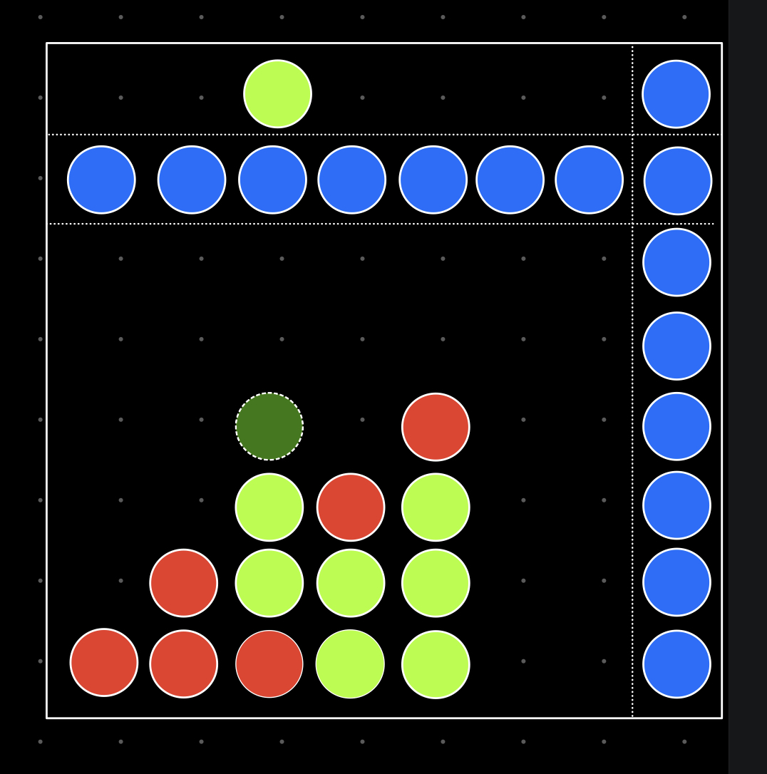
How to know who has won

Slide 10
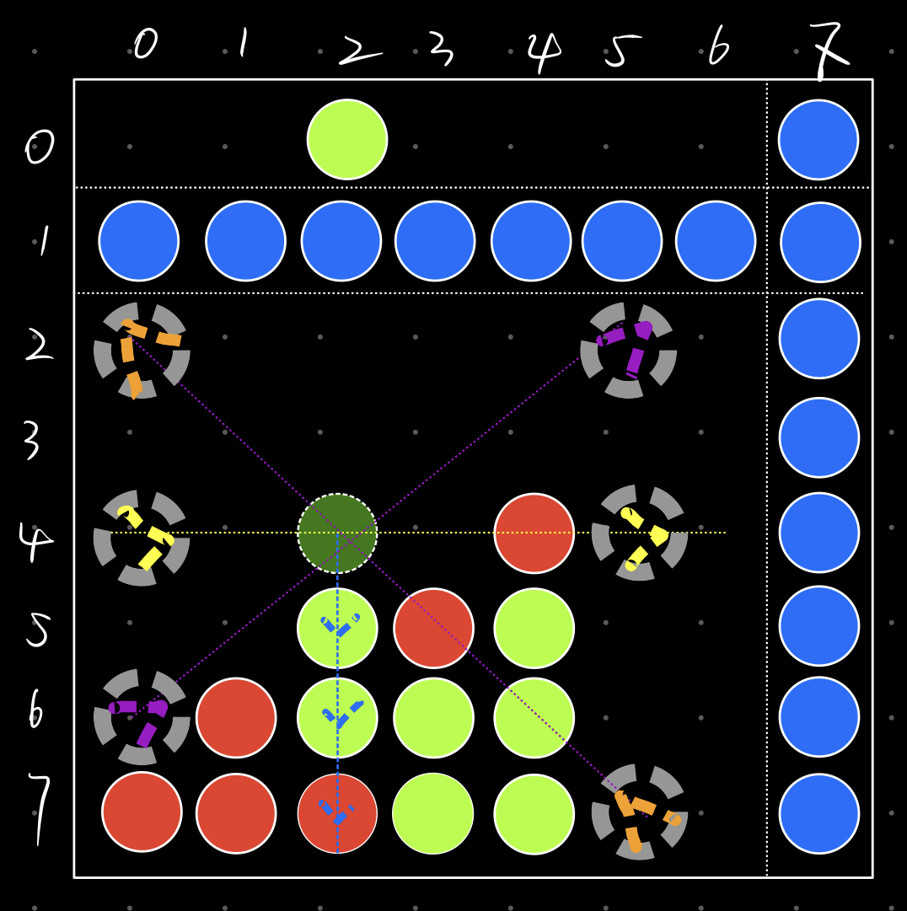
How to know who has won
Horizontal:
From Left to right check whether connected 4
Vertical:
Check whether has enough room below,
Check four connected positions below
from the top down
Diagonal:
Find the bottom left position,
Check four connected positions to the top right
Find the bottom right position,
Check four connected positions to the top left

Slide 11
THE END

